Slide 1
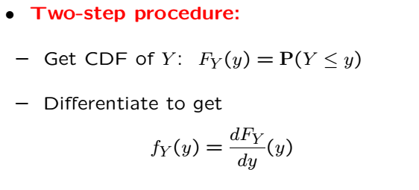
Continuous Case

Slide 2
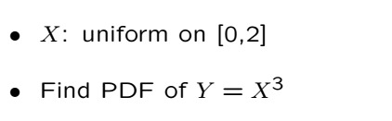
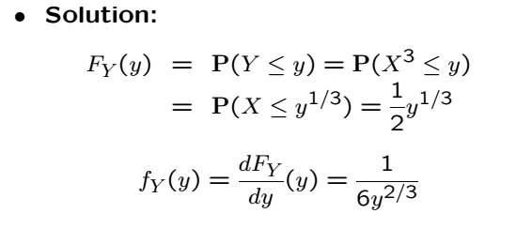
Example

Slide 3




Example: Squaring a Uniform RV
X is a uniform RV over (-1,1), and
Note that W is always positive, even though X isn’t
Notes:
Example 6.4

Slide 4


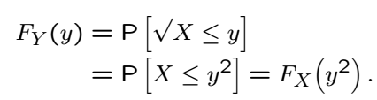
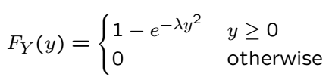
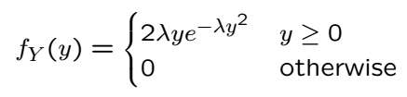
Example: Square Root
RV
; X is exponentially distributed
Application in wireless comms: SNR distribution of fading links
Notes:
Example 6.4

Slide 5
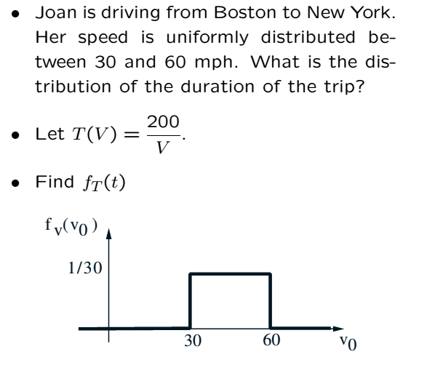
Example

Slide 7

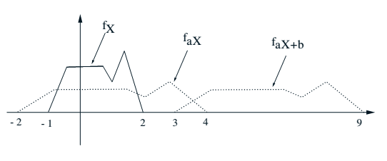
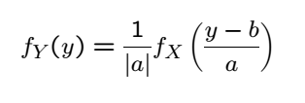
PDF of Linear and Affine Functions

Slide 8


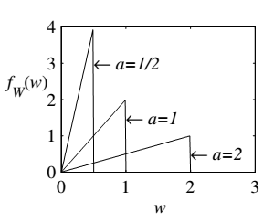
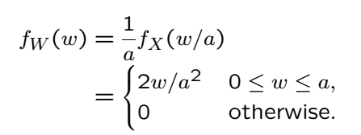
Example
Notes:
6.3

Slide 9



What if X is Normal?
Y is also normal! What are the mean and variance of Y?

Slide 10
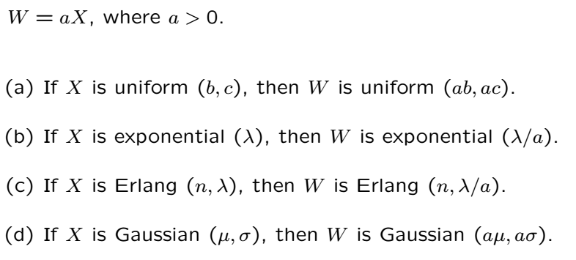
Stretching Other Distributions

Slide 11
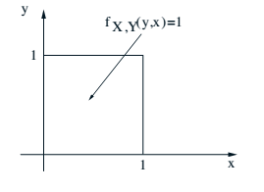
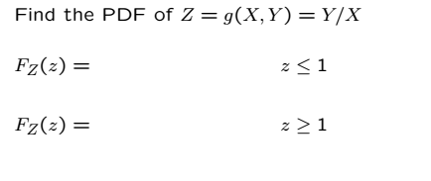
CDF of a Ratio of Two RVs

Slide 12
Acknowledgements and Citations
Parts of these slides are adapted from the following resources:
Power Point Lecture Slides for the Textbook http://bcs.wiley.com/hebcs/Books?action=index&bcsId=8676&itemId=1118324560
John Tsitsiklis. 6.041 Probabilistic Systems Analysis and Applied Probability, Fall 2010. (Massachusetts Institute of Technology: MIT OpenCourseWare),http://ocw.mit.edu (Accessed 13 Apr, 2015). License: Creative Commons BY-NC-SA

